Slide 1
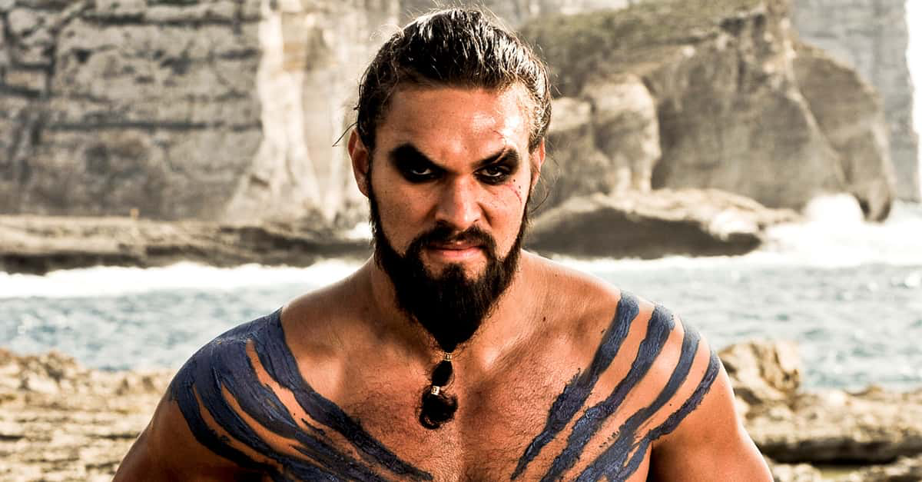
Notes:
Khal Drogo

Slide 2
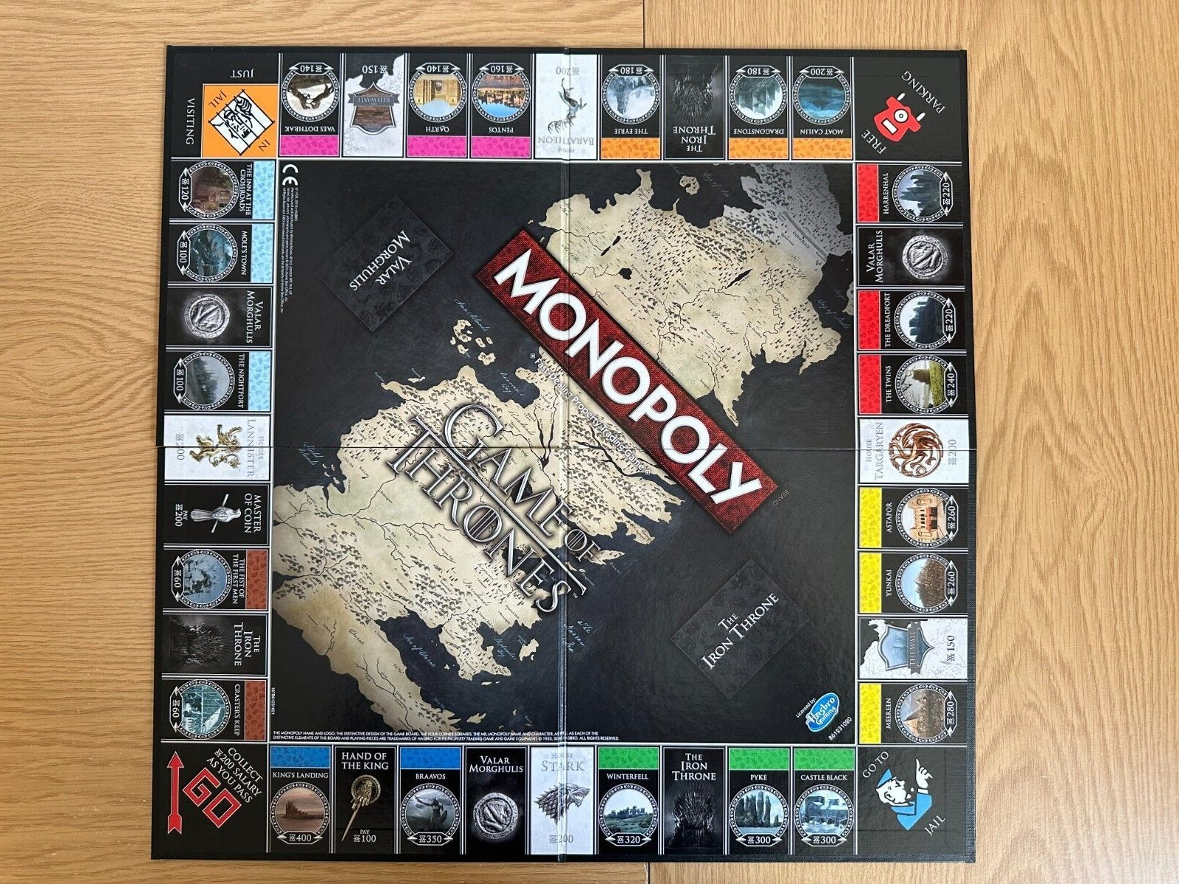
Notes:
Monopoly

Slide 3
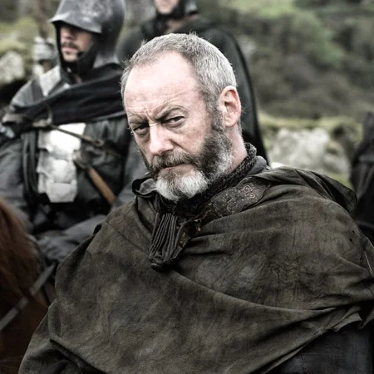
Notes:
Davos

Slide 4
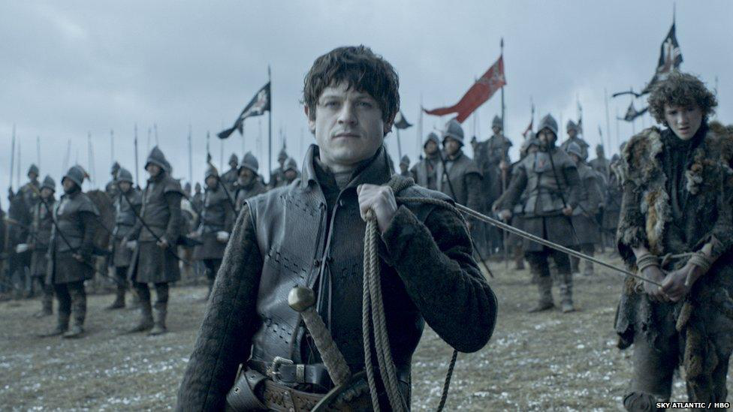
Notes:
Ramsay Bolton

Slide 5
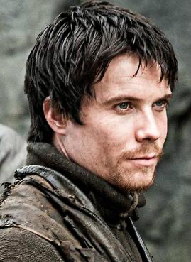
Notes:
Gendry

Slide 6
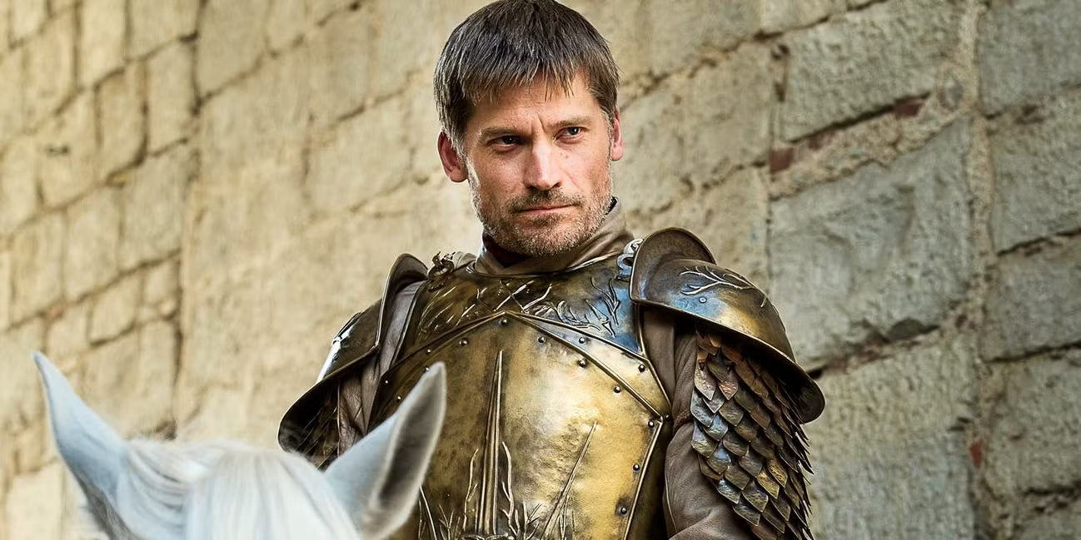
Notes:
Jamie Lannister

Slide 7
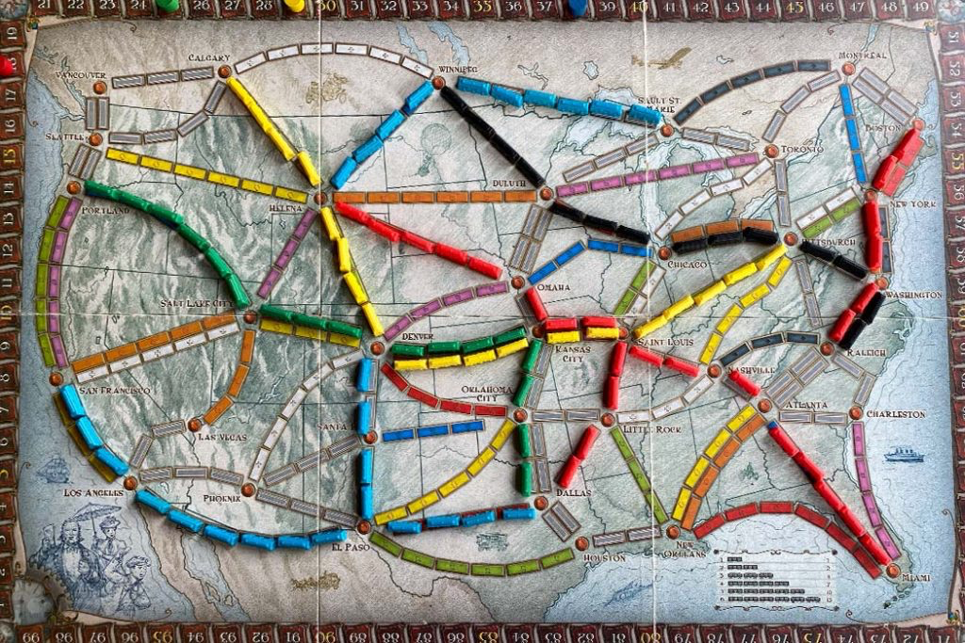
Notes:
Ticket to Ride

Slide 8
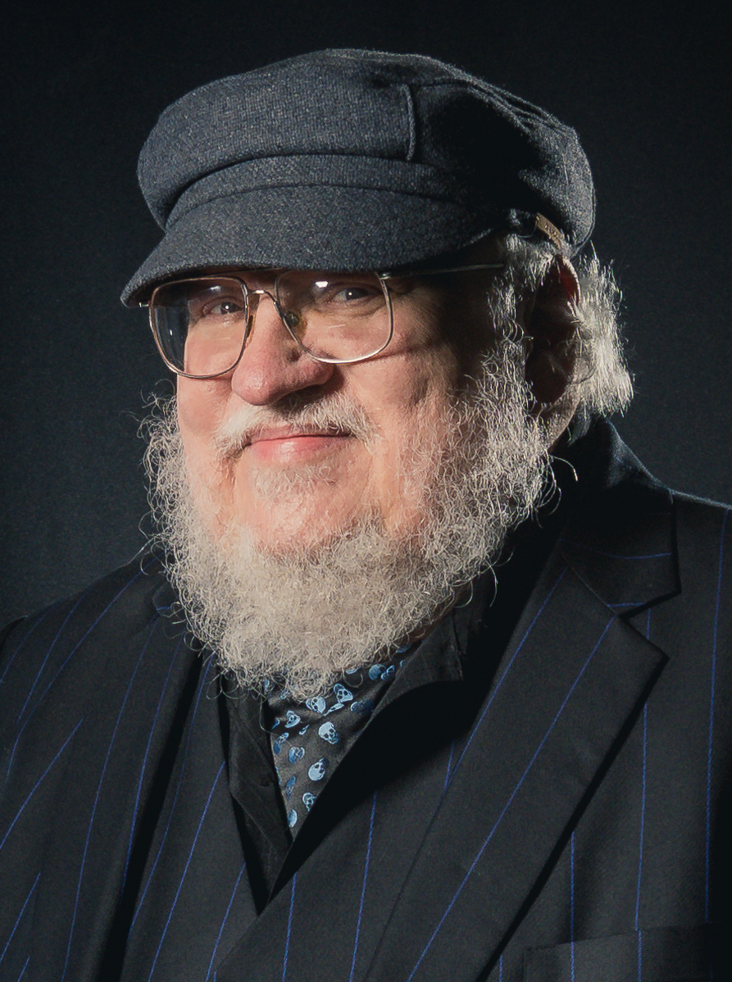
Notes:
George RR Martin

Slide 9

Notes:
House Stark

Slide 10
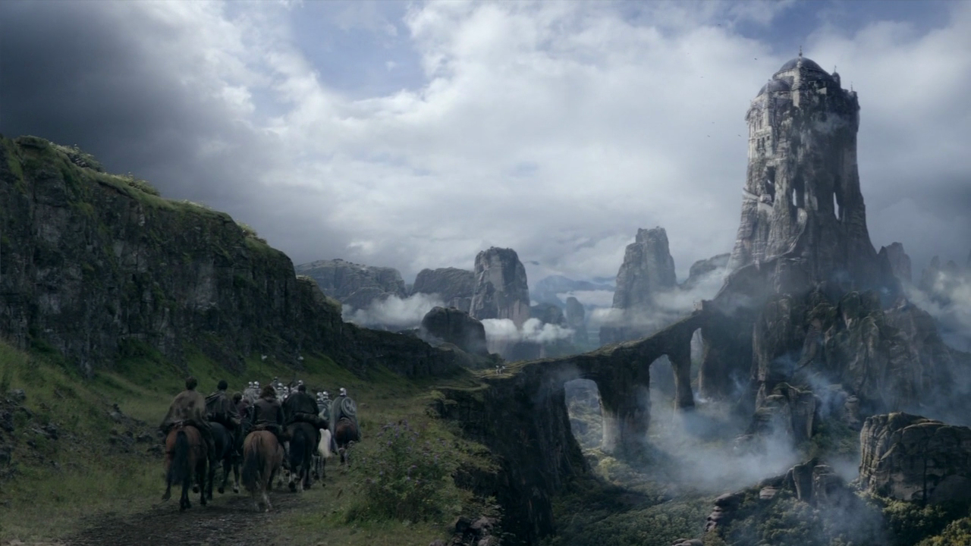
Notes:
The Eyrie

Slide 11
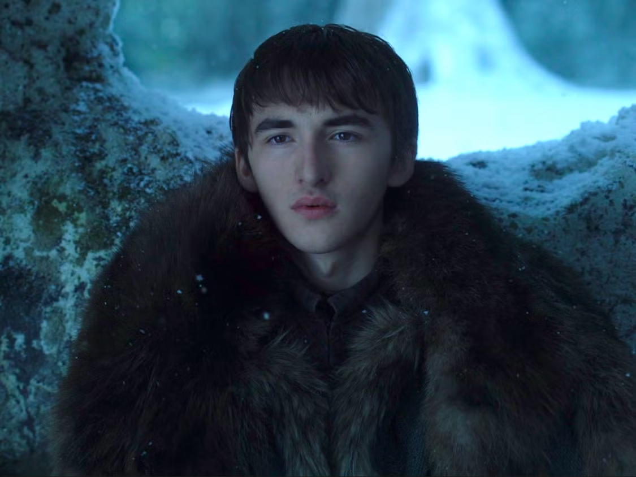
Notes:
Bran Stark

Slide 12
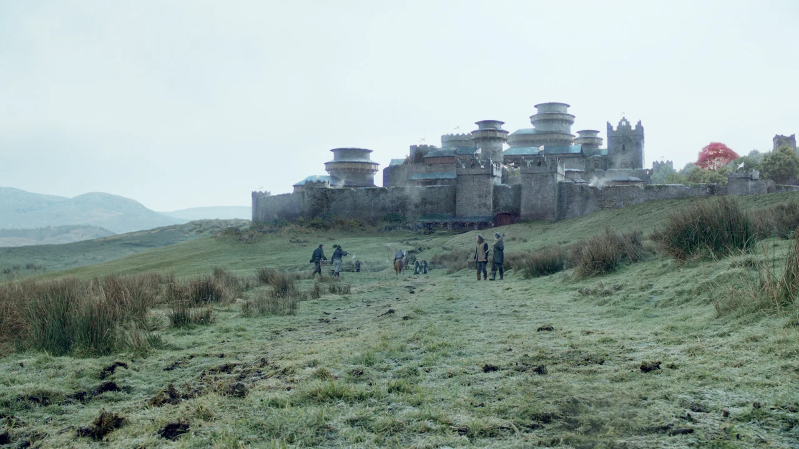
Notes:
Winterfell

Slide 13
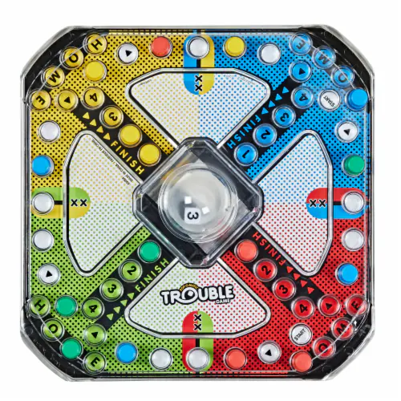
Notes:
Trouble

Slide 14
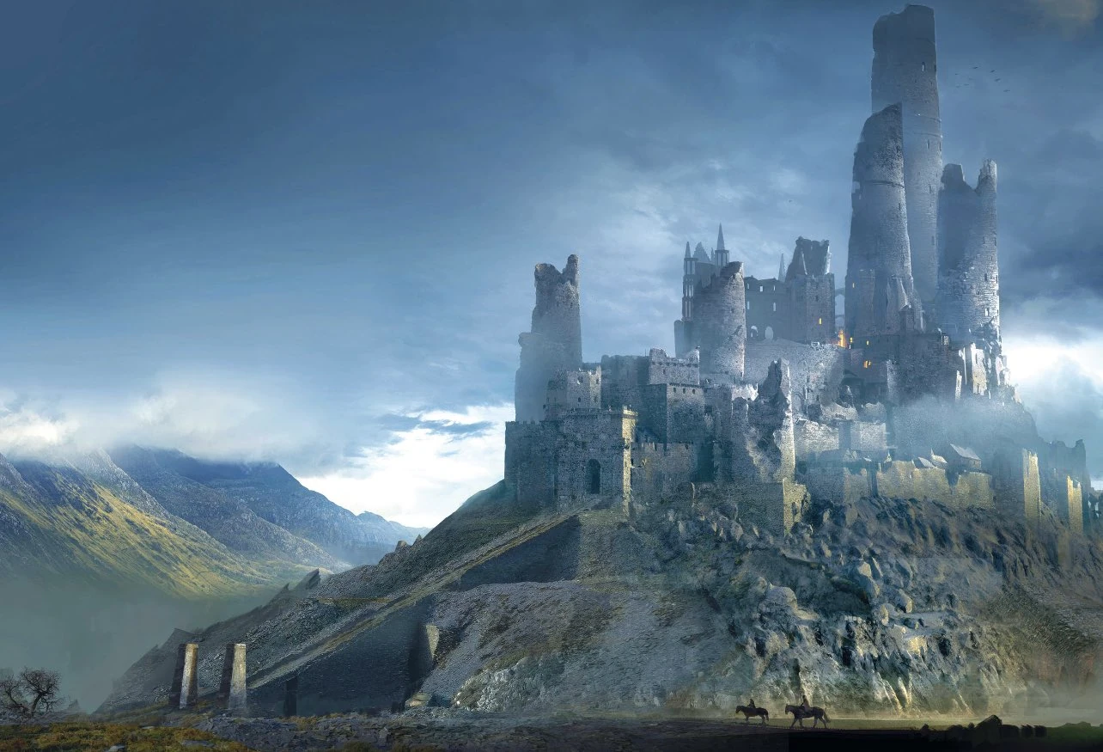
Notes:
Harrenhall

Slide 15
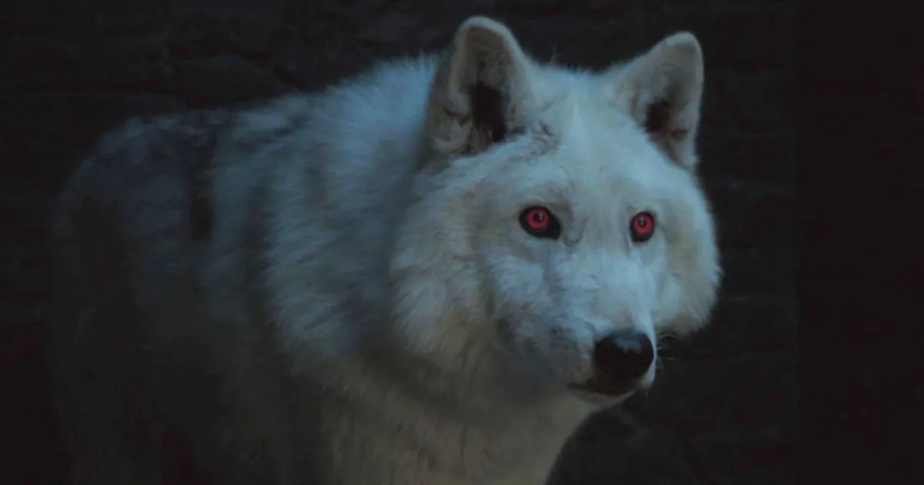
Notes:
Ghost

Slide 16
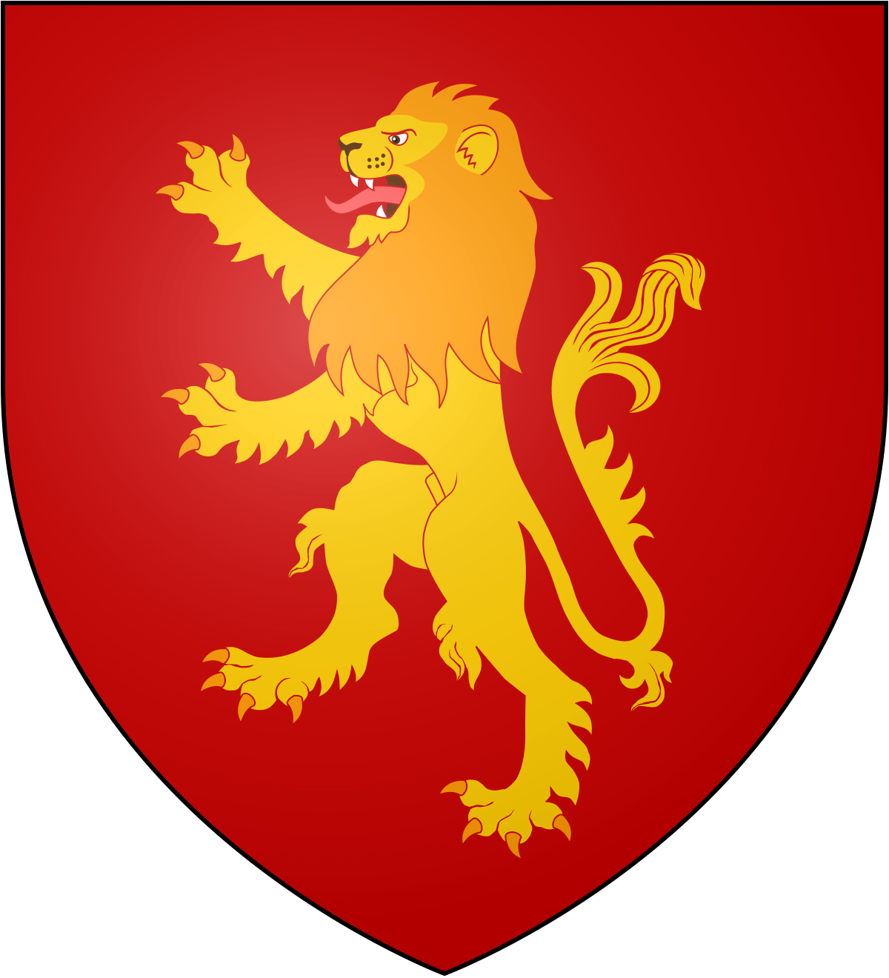
Notes:
House Lannister

Slide 17
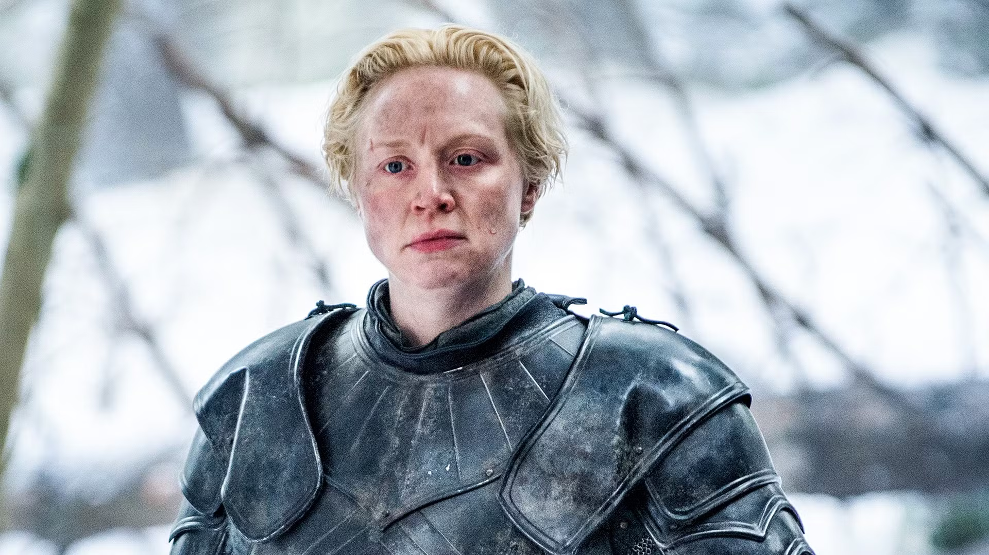
Notes:
Brienne of Tarth

Slide 18
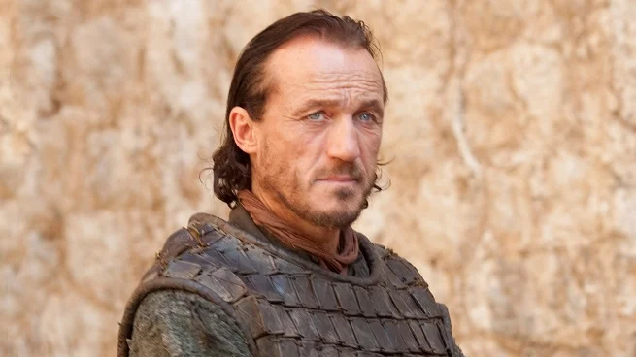
Notes:
Bronn

Slide 19
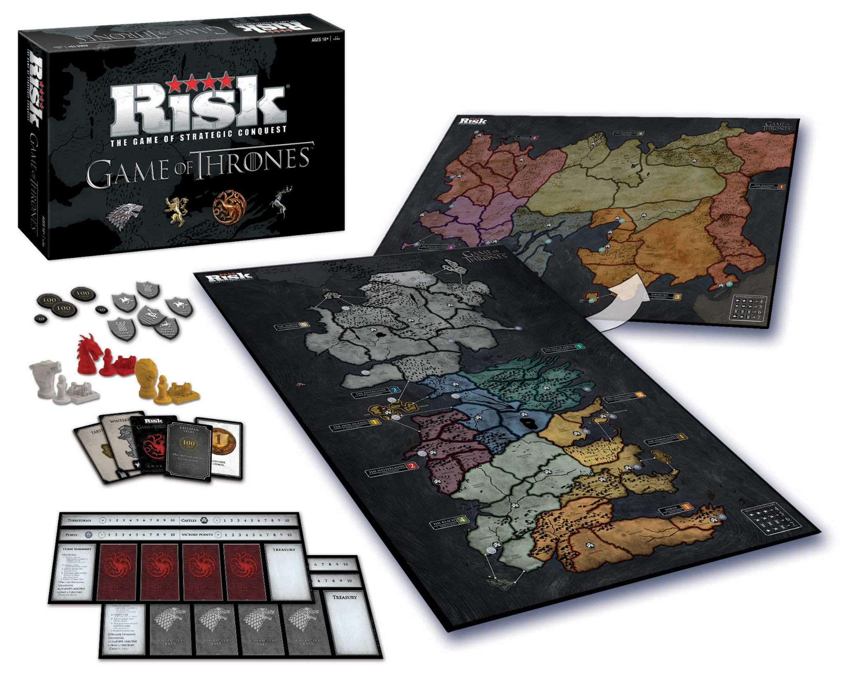
Notes:
Risk

Slide 20
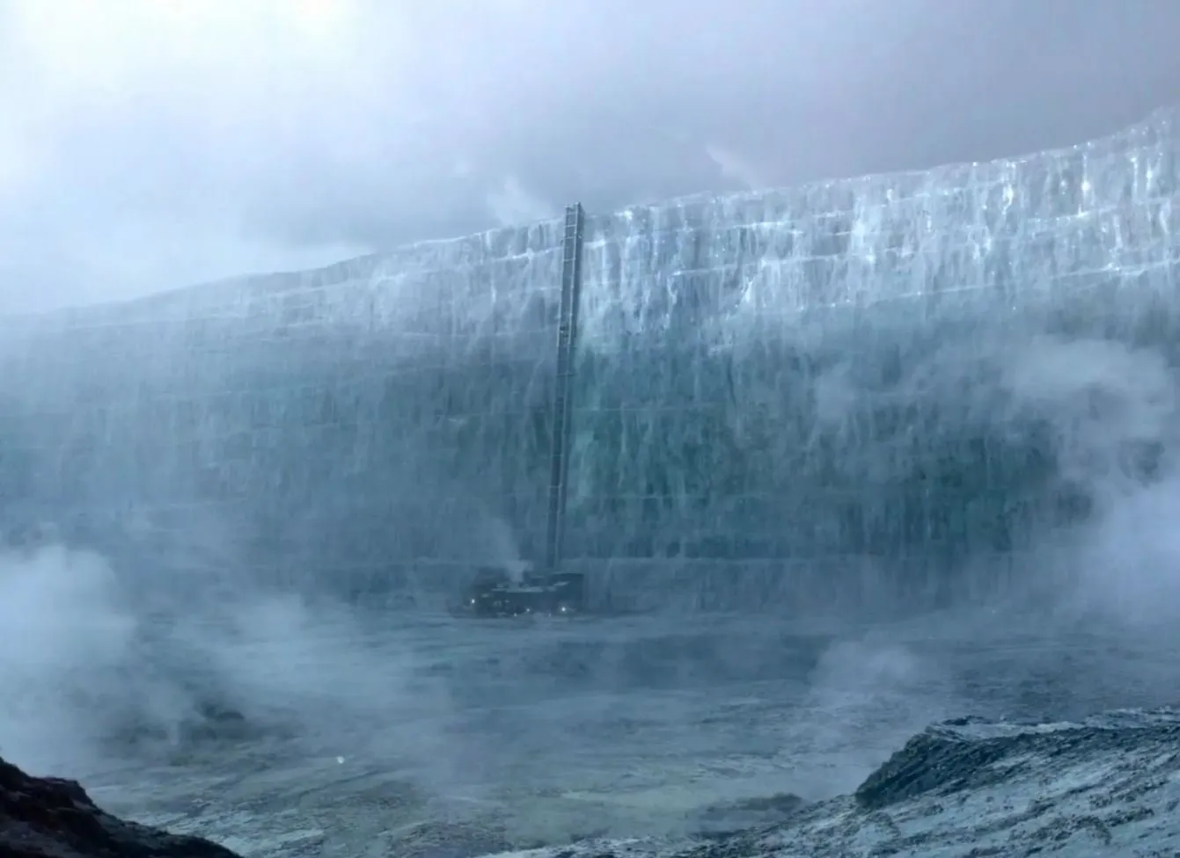
Notes:
The Wall

Slide 21
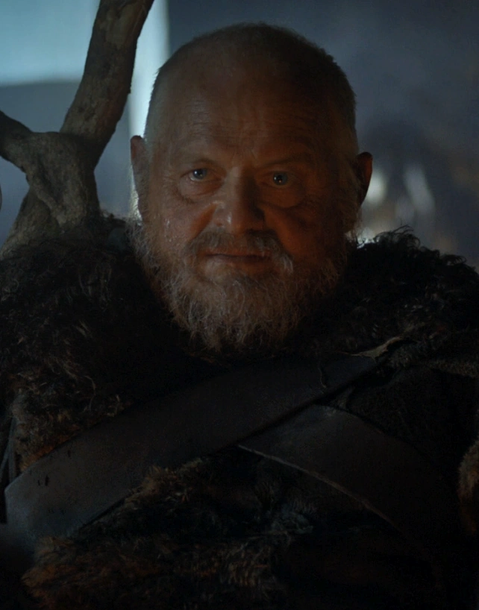
Notes:
Craster

Slide 22
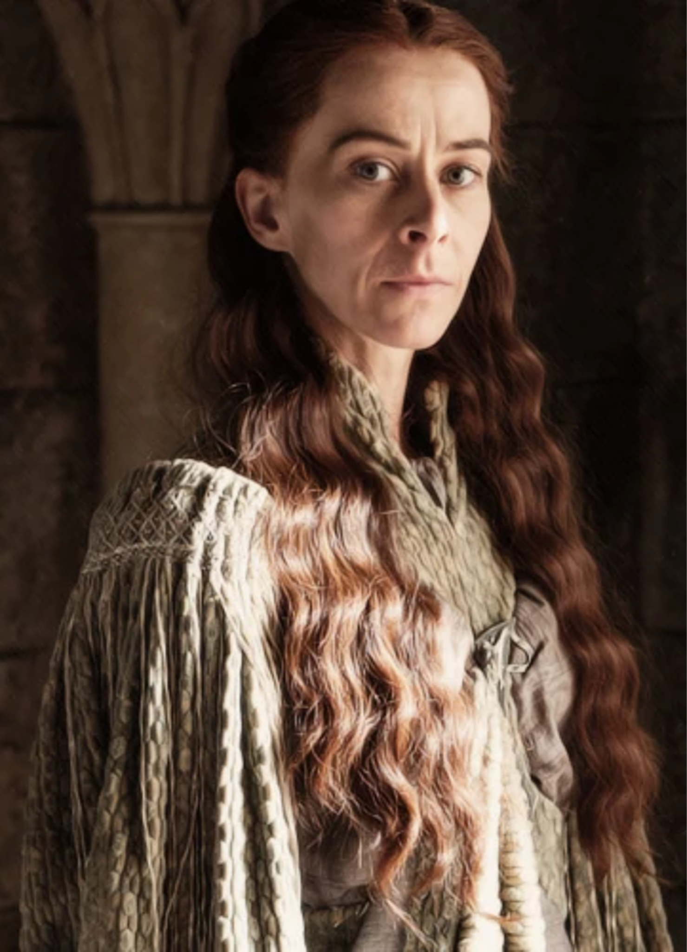
Notes:
Lysa Arryn

Slide 23
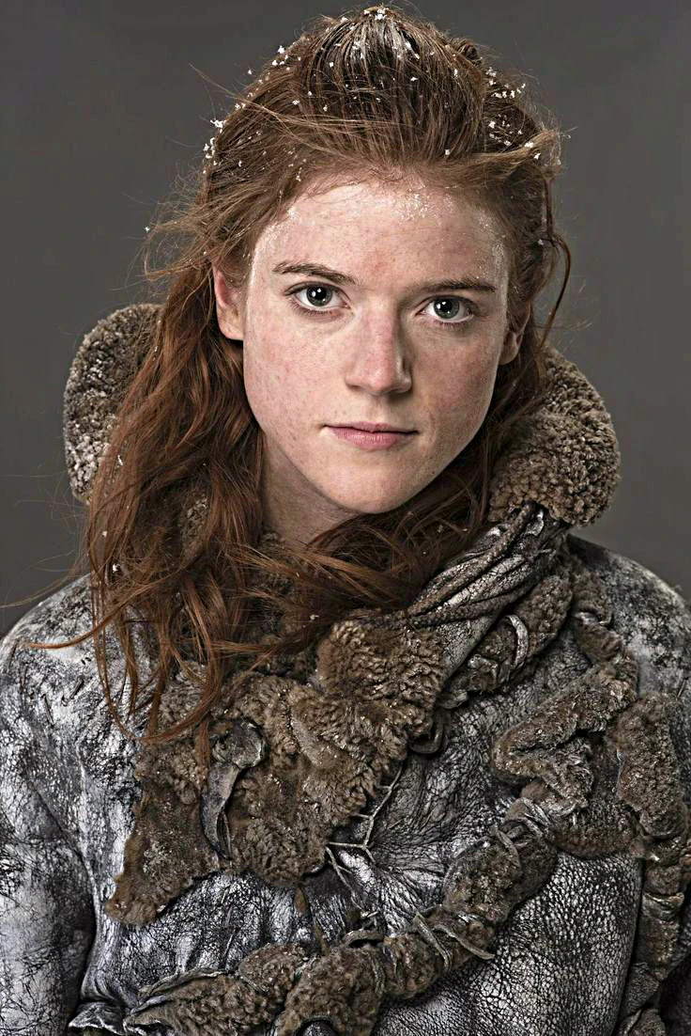
Notes:
Ygritte

Slide 24

Notes:
Uno

Slide 25
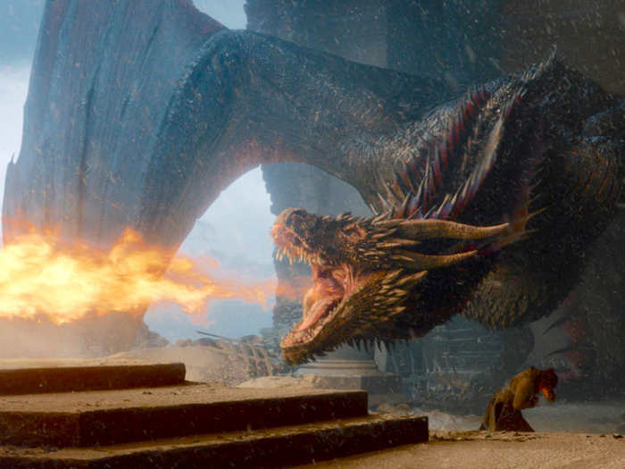
Notes:
Drogon

Slide 26
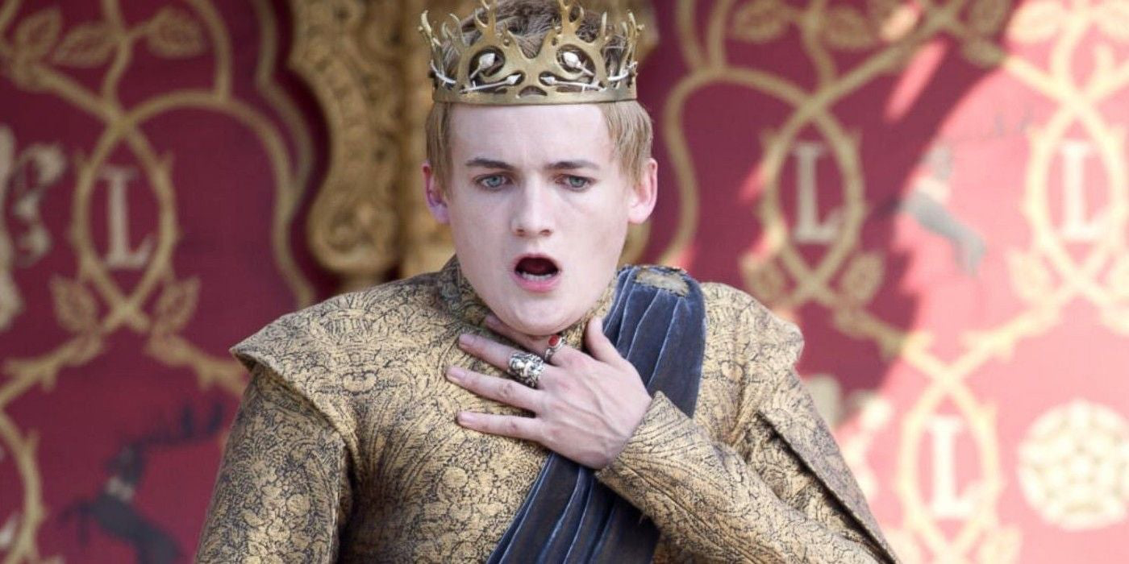
Notes:
Joffrey Baratheon

Slide 27
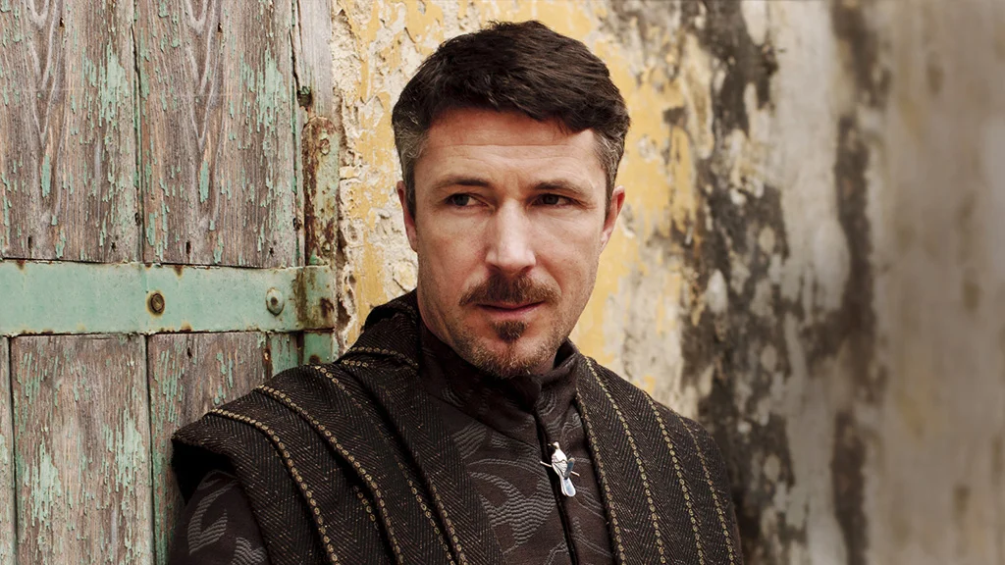
Notes:
Little Finger/Lord Baelish

Slide 28
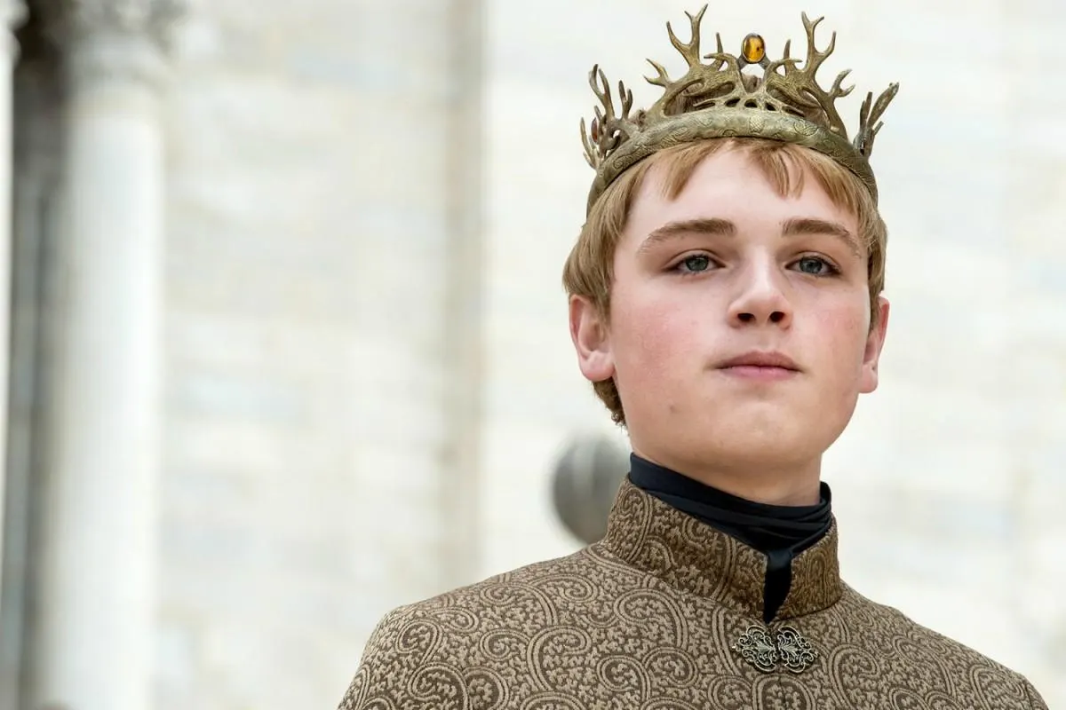
Notes:
Tommen Baratheon

Slide 29
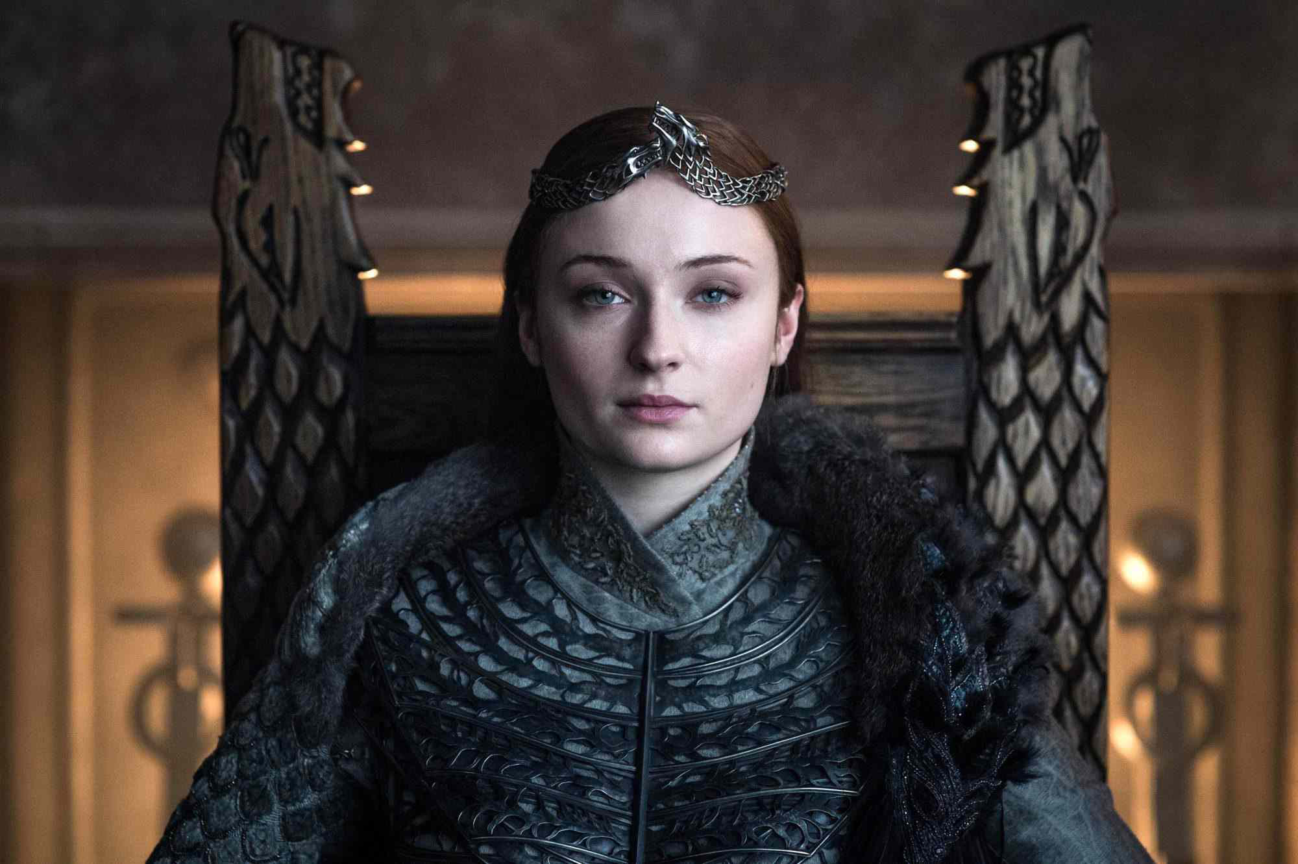
Notes:
Sansa Stark

Slide 30
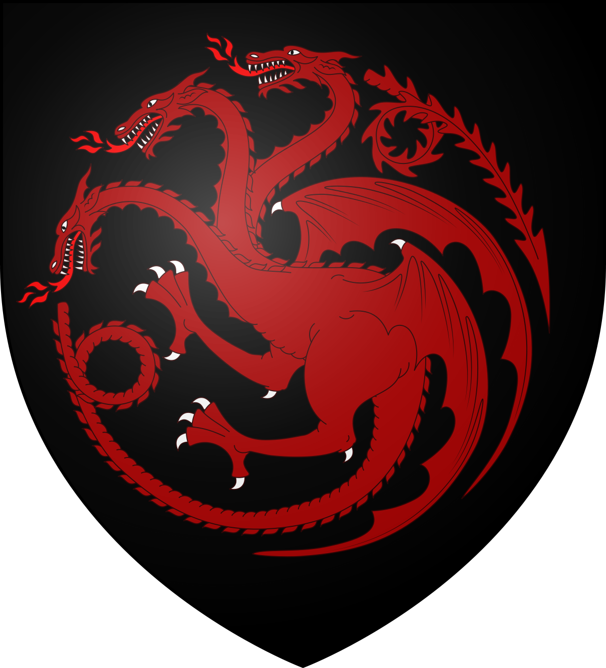
Notes:
Targaryan crest

Slide 31
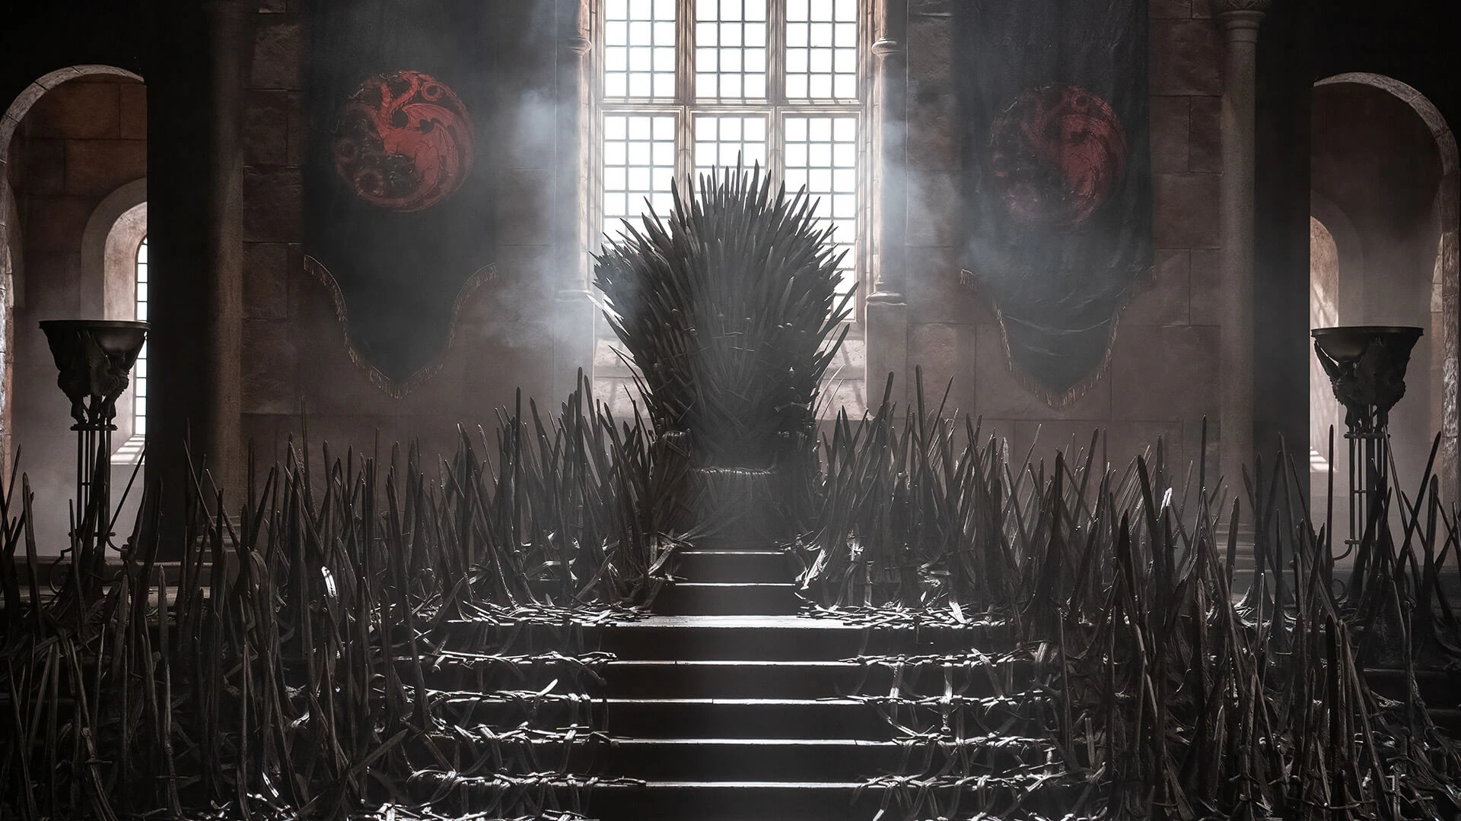
Notes:
Iron Throne

Slide 32
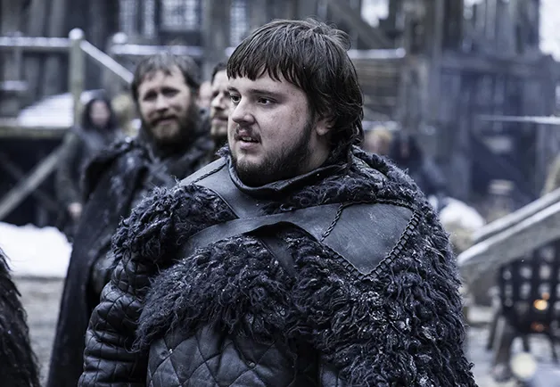
Notes:
Sam Tarly

Slide 33
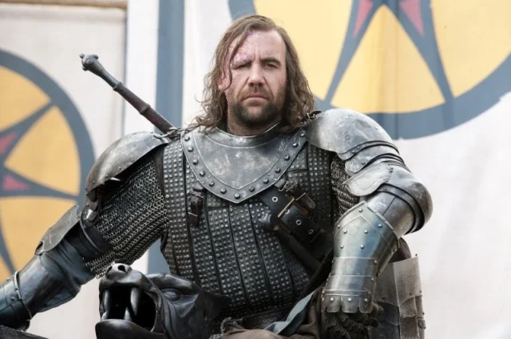
Notes:
Sandor Clegane/The Hound

Slide 34
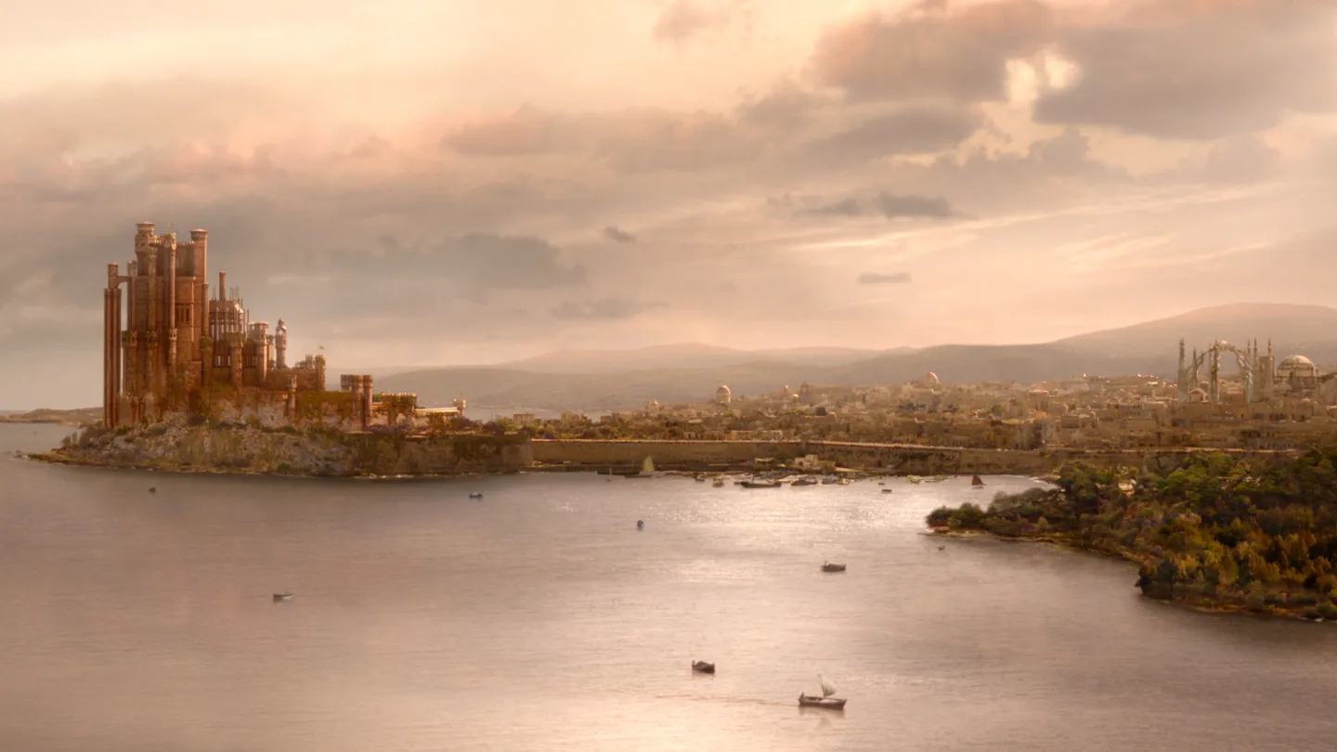
Notes:
King’s Landing

Slide 35
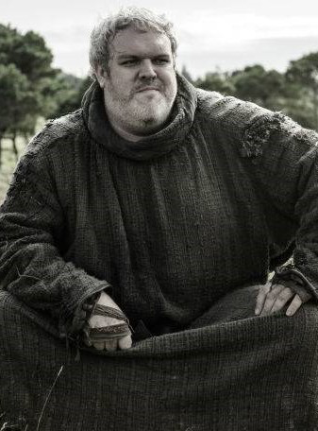
Notes:
Hodor

Slide 36
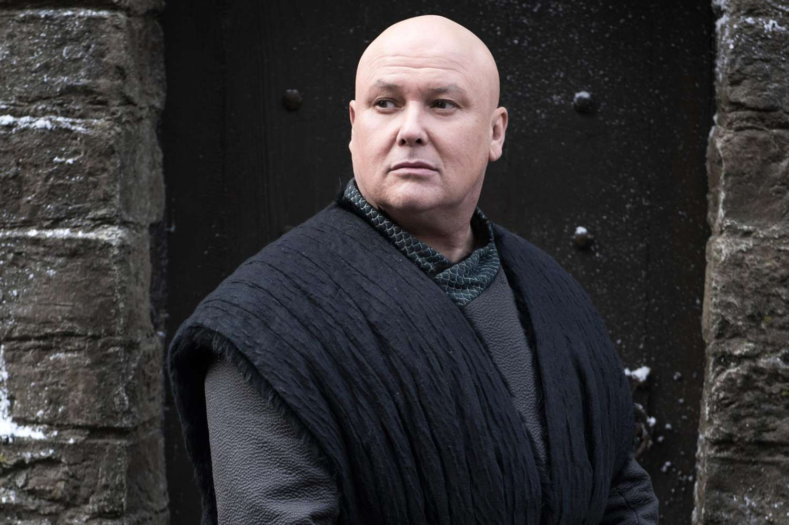
Notes:
Varys

Slide 37
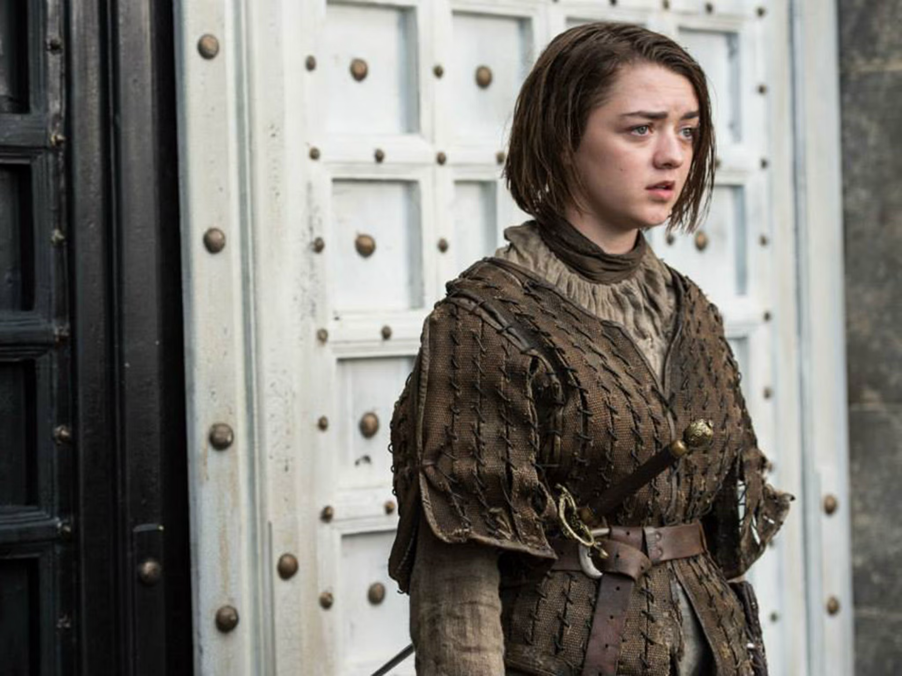
Notes:
Arya Stark

Slide 38
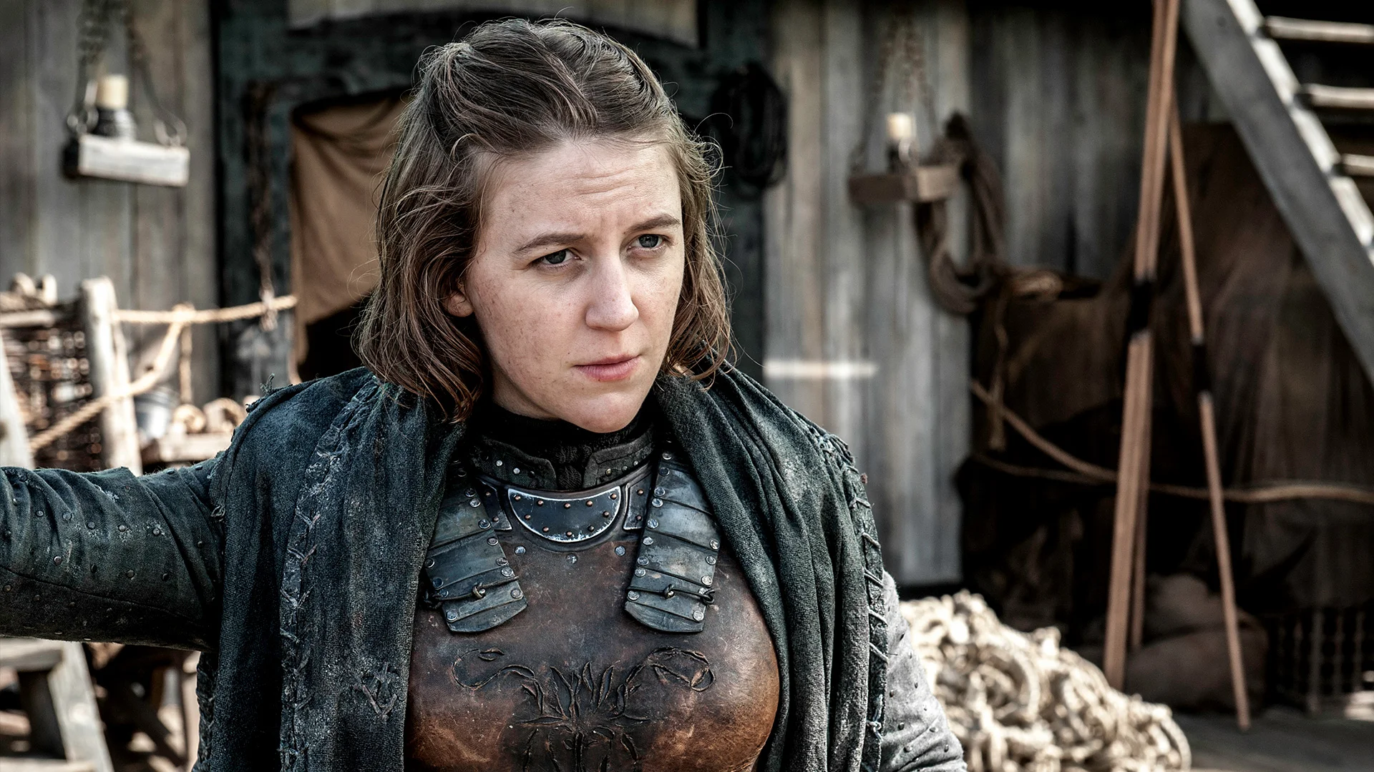
Notes:
Yara Greyjoy

Slide 39
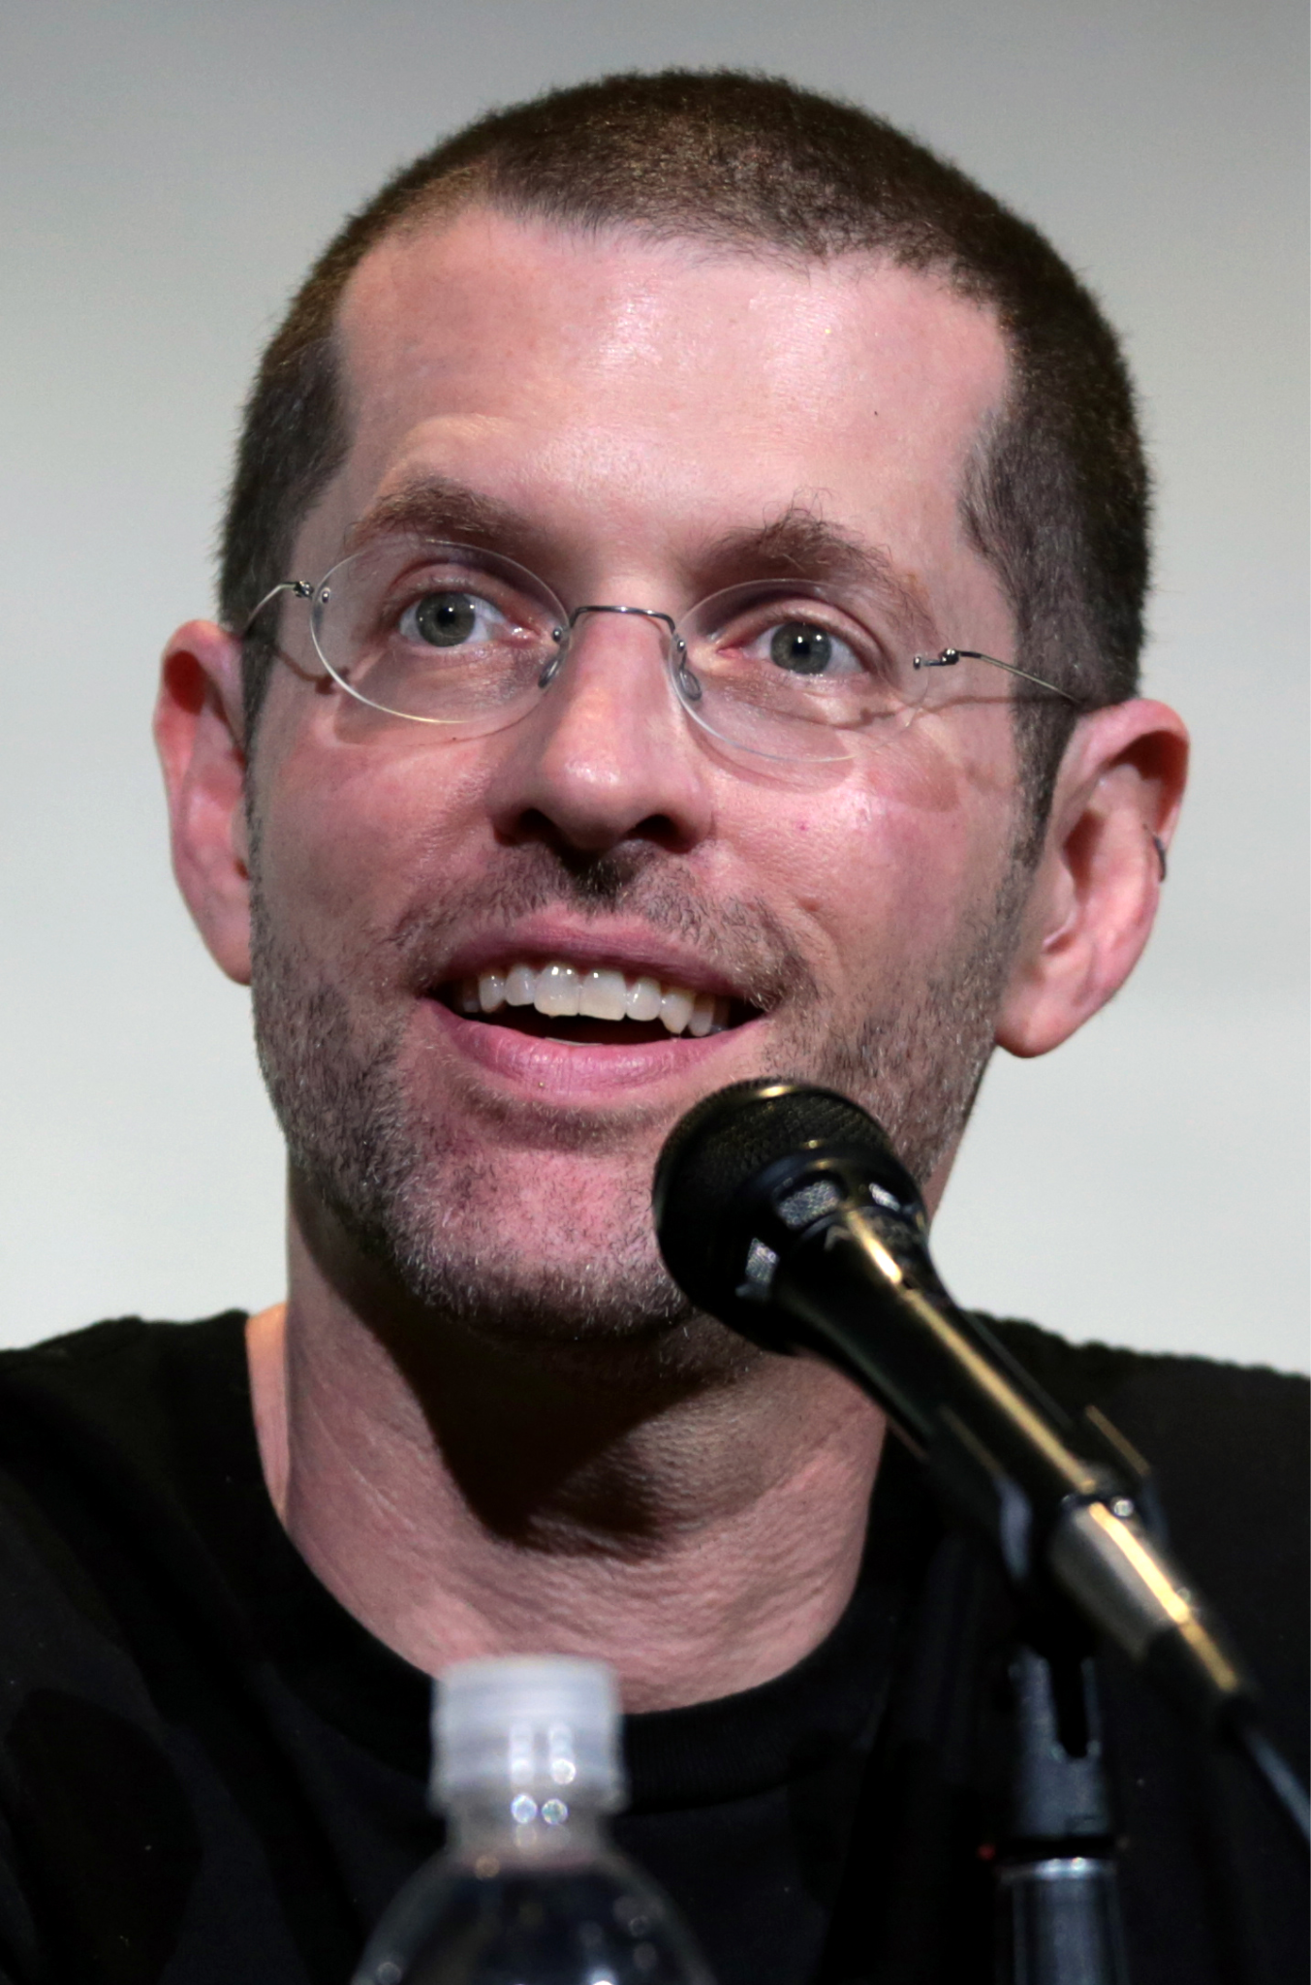
Notes:
David Weiss

Slide 40
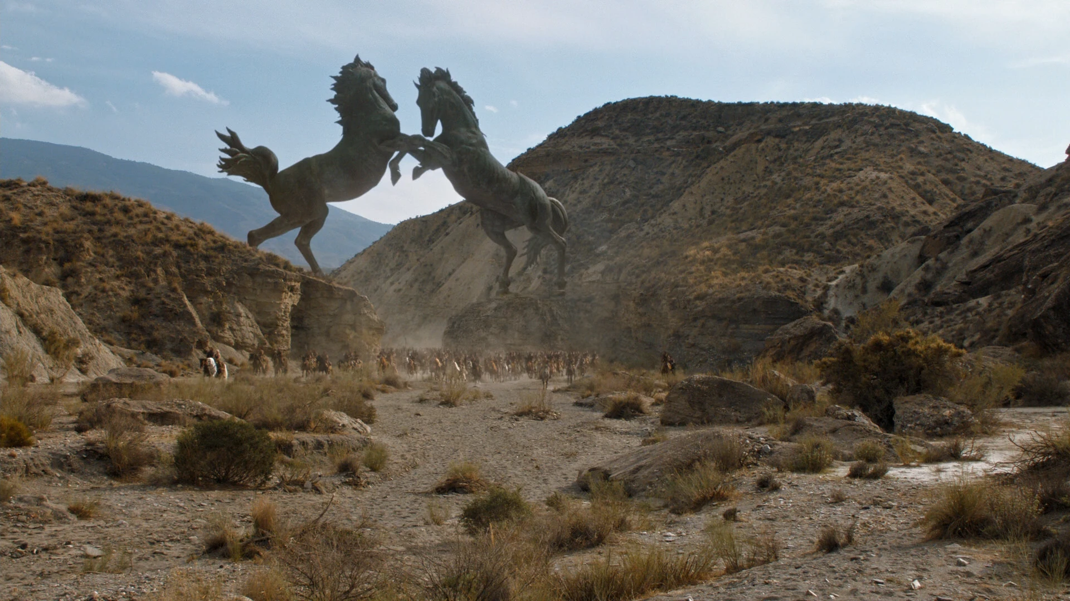
Notes:
Vaes Dothrak

Slide 41
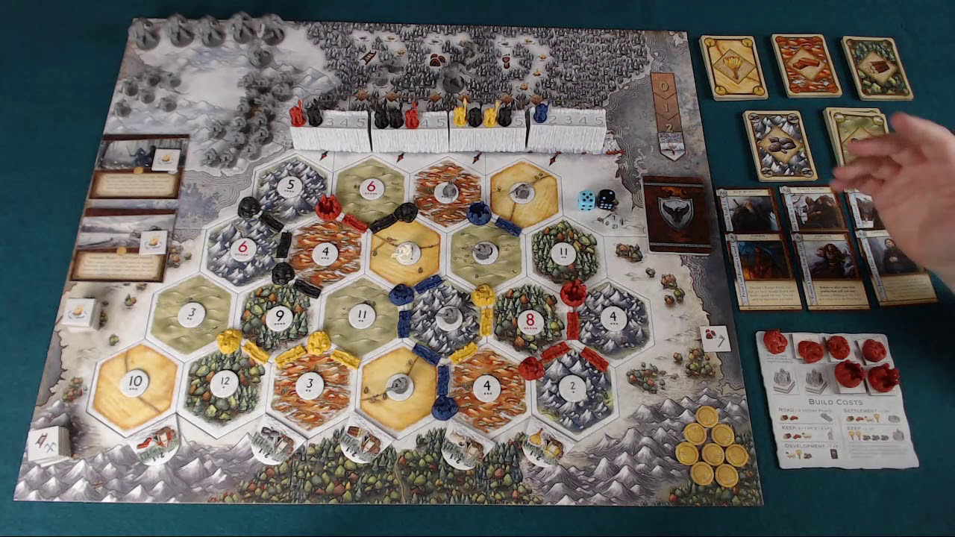
Notes:
Catan

Slide 42
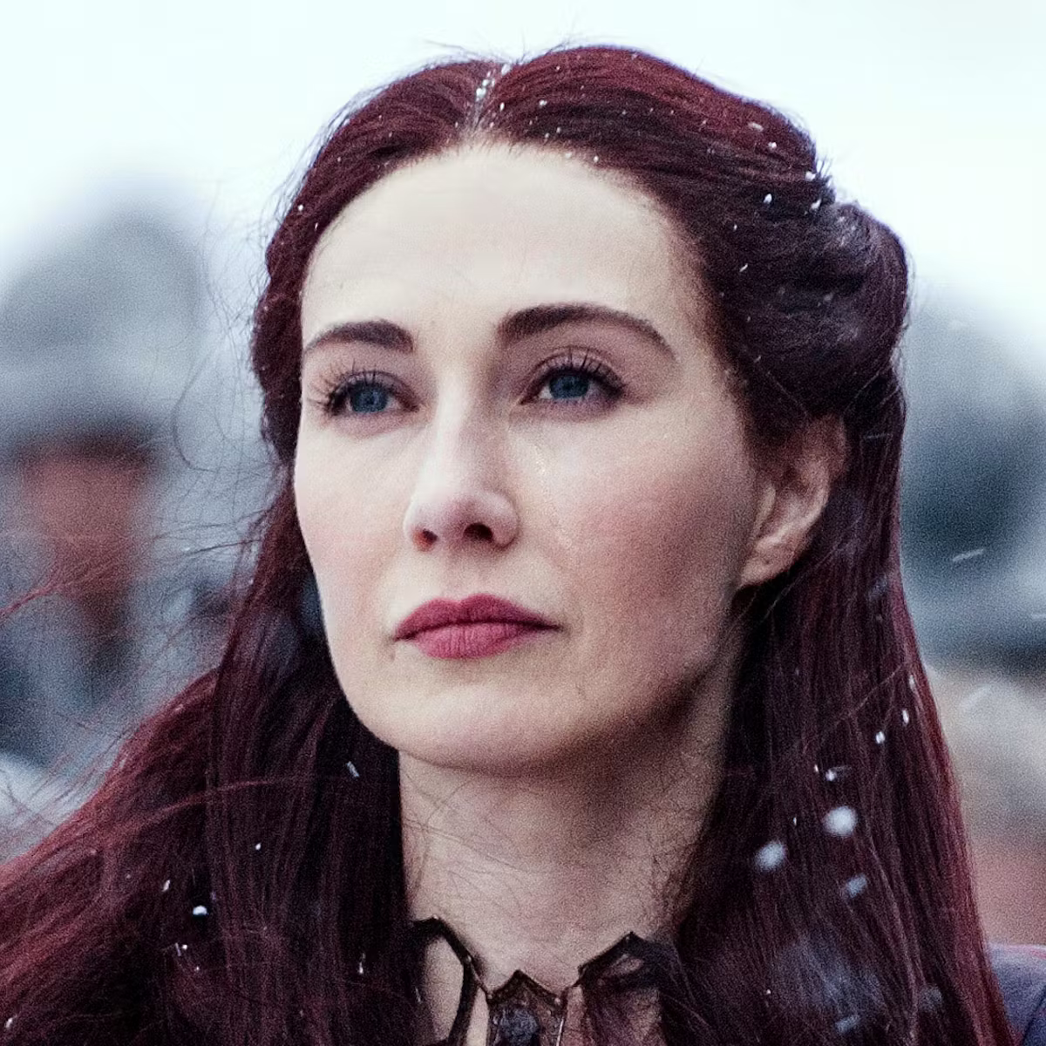
Notes:
Melisandre

Slide 43
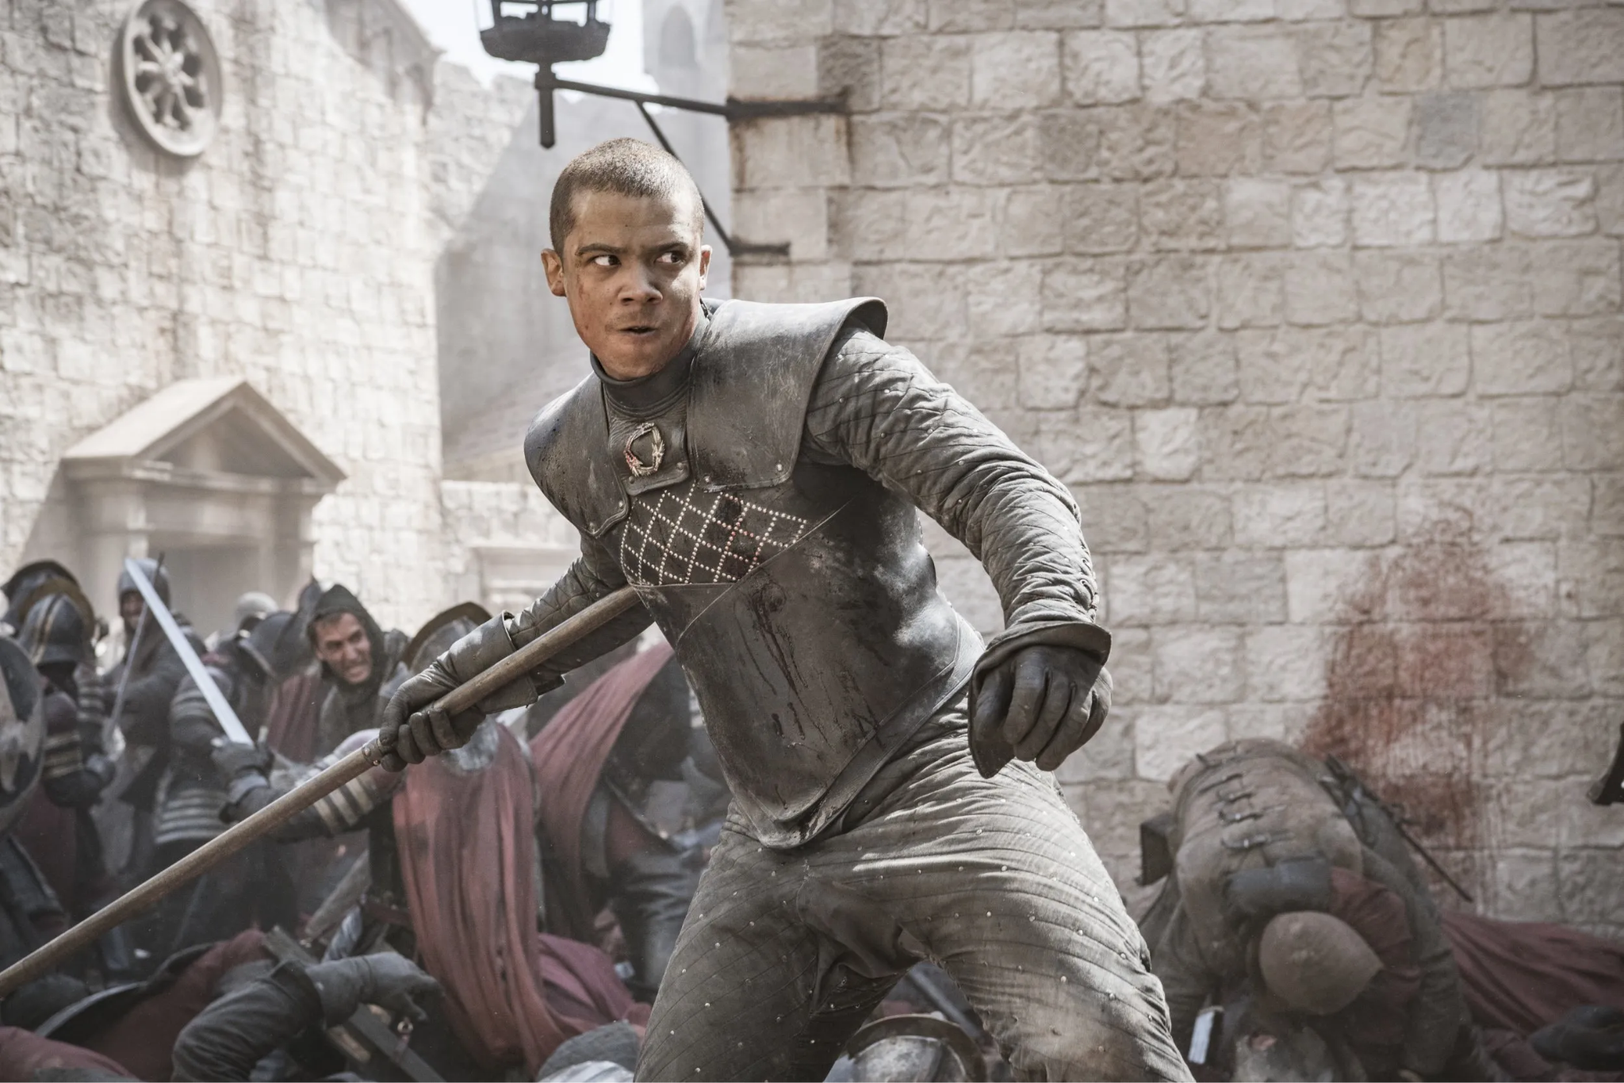
Notes:
Grey Worm

Slide 44
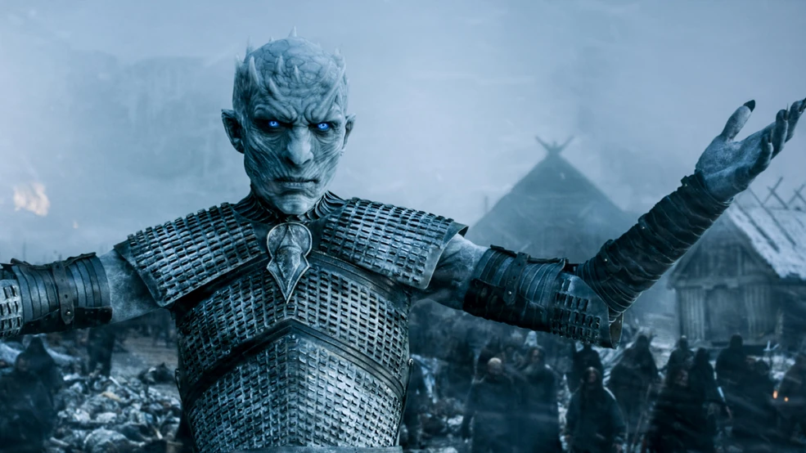
Notes:
Night King

Slide 45
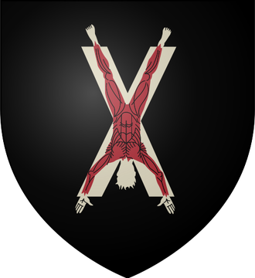
Notes:
House Bolton

Slide 46
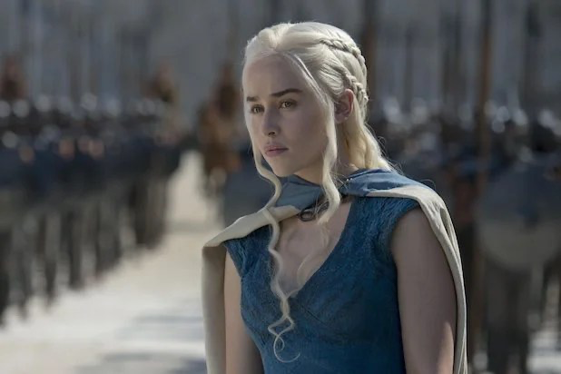
Notes:
Daenerys Targarian

Slide 47
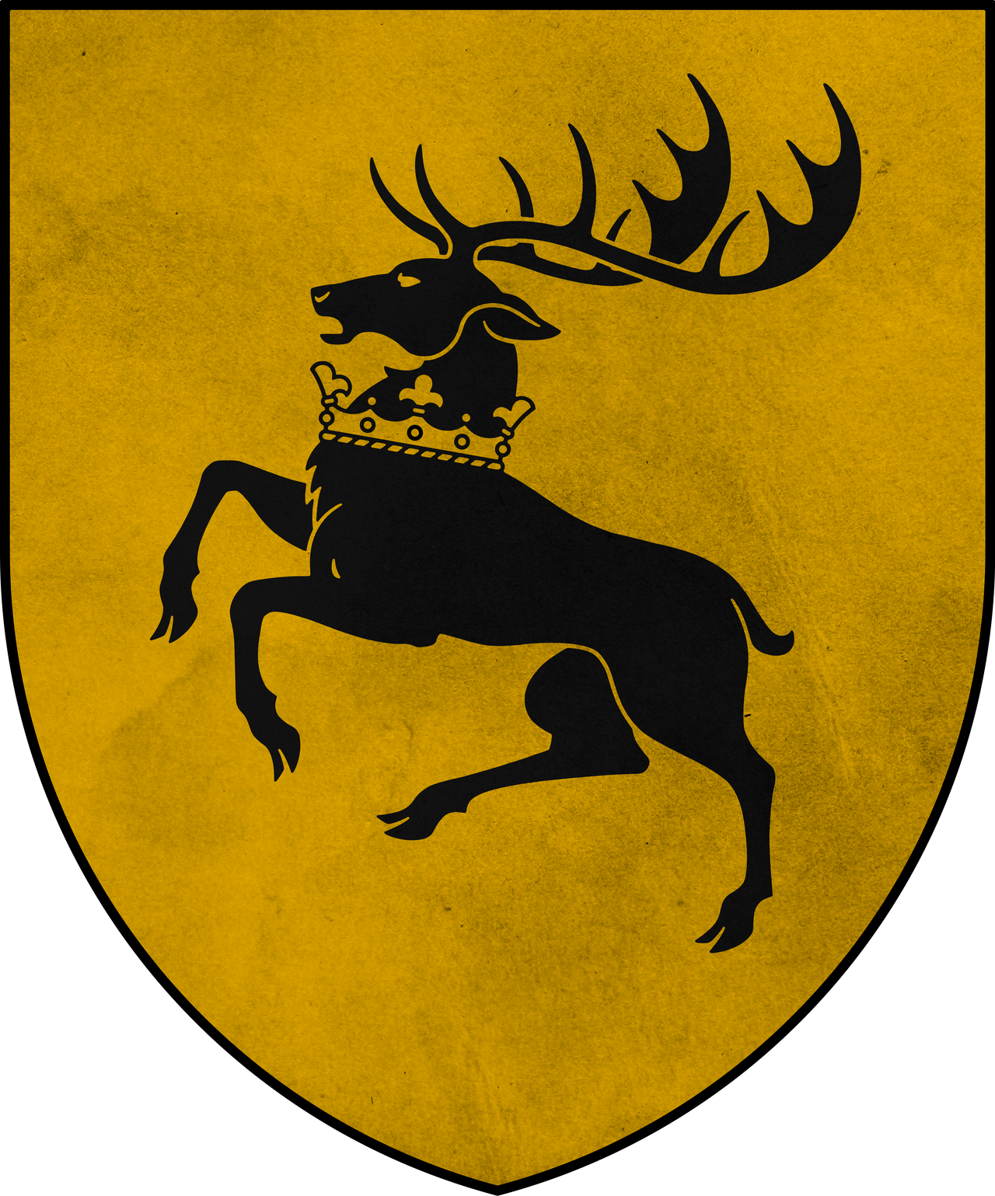
Notes:
House Baratheon

Slide 48
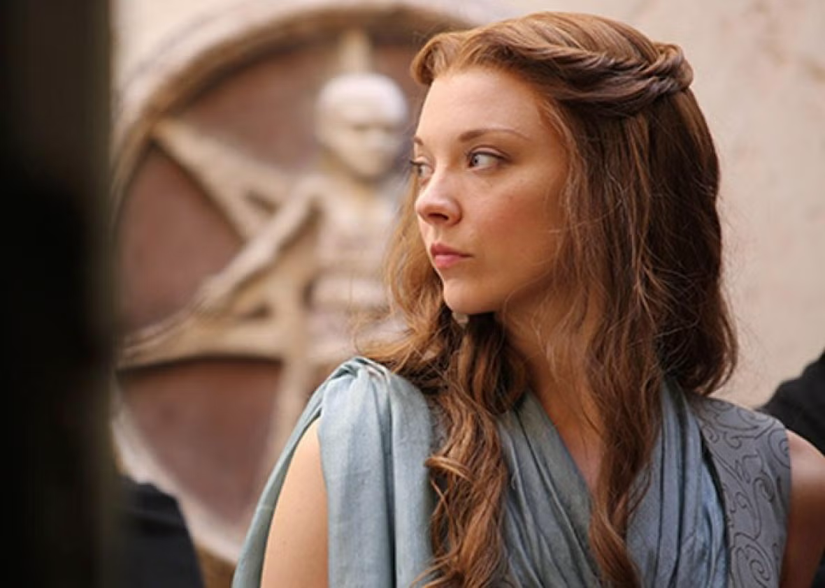
Notes:
Margaery Tyrell Game of Thrones

Slide 49

Notes:
House Frey

Slide 50
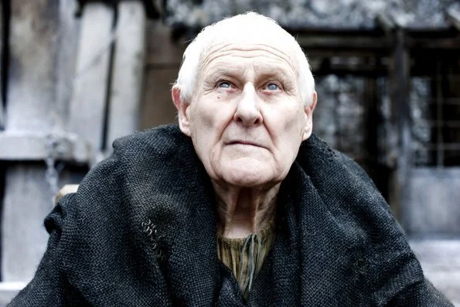
Notes:
Maester Aemon

